Slide 1

Section 2 – us arrest datasets
Kenneth koh kai zhen

Slide 2
objectives
Categorize US states based on their characteristics from the given datasets
Factors that are statistically significant in predicting Assault rates

Slide 3
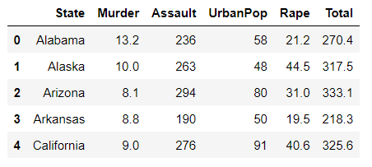
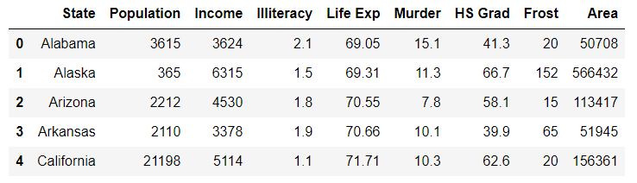
Datasets used
USArrest.csv – Main dataset to use for analysis as the dataset consists of the numeric numbers for 3 violent crime rates (Assault, Murder, Rape) of 50 US states
USstatex77.csv – Complementary dataset that contains murder rate as well as other features such as illiteracy, life expectancy, per capital income

Slide 4
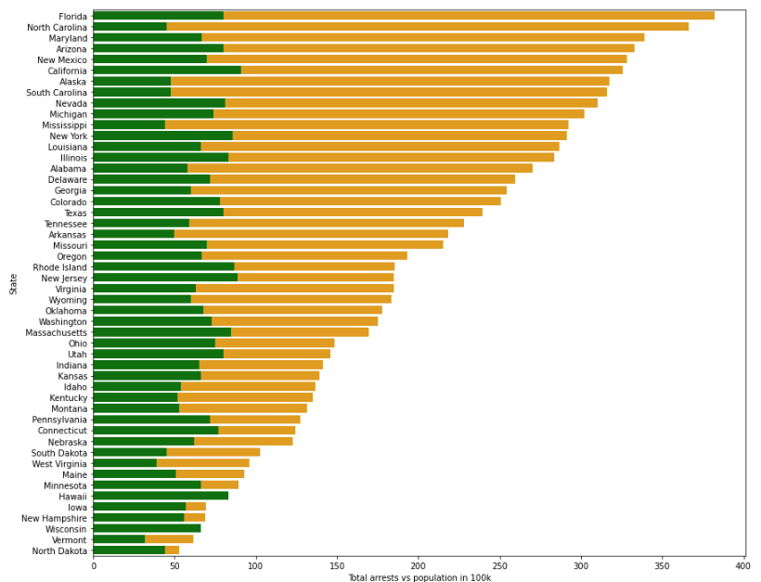
data visualisation from USArrest.csv
Stacked Bar chart
Horizontal Axis: Total numbers of Arrest and population in 100k
Vertical Axis: Name of State
Top 3 states with the highest number of arrests in Year 1973 :
Florida, North Carolina, Maryland
Top 3 states with the lowest number of arrests:
North Dakota, Vermont, Wisconsin
Legend:
Orange
Green

Slide 5
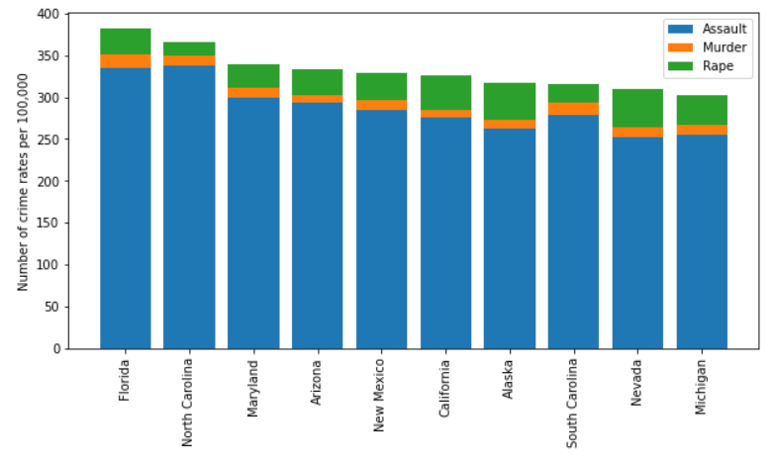
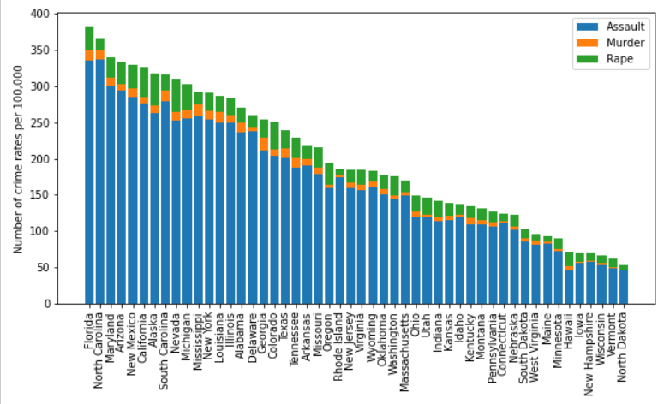
data visualisation from USArrest.csv
Stacked Bar Chart
– Top 10 States with the highest crime rates
Horizontal Axis: Name of State
Vertical Axis: Number of crime rates in 100k
Among the different types of violent crime, Assaults have the highest number of cases in terms of crime rate followed by rape and murder through the country.

Slide 6
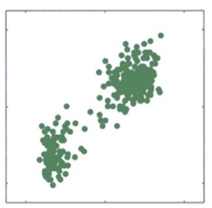
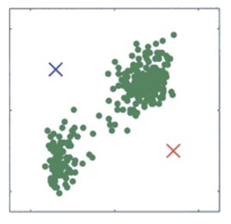
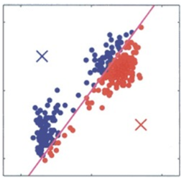
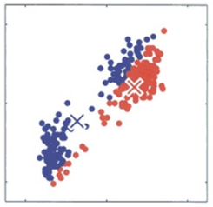
Processing method – K-means Clustering
K-Means Clustering is a form of unsupervised machine learning
It is an centroid-based/distance-based algorithm that tries to group similar items in the form of clusters
Step 1: Choose the number of clusters k
Step 2: Select k random points from the data as centroids
Step 3: Assign all the points to the closest cluster centroid
Step 4: Recompute the centroids of newly formed clusters
Step 5: Repeat steps 3 and 4 (Iterative process)
Step 1
Step 2
Step 3
Step 4

Slide 7
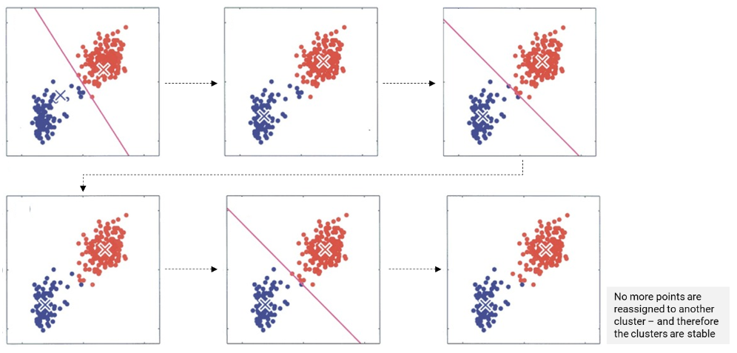
Processing method – K-means Clustering
Step 5: Repeat steps 3 and 4 (Iterative process)

Slide 8
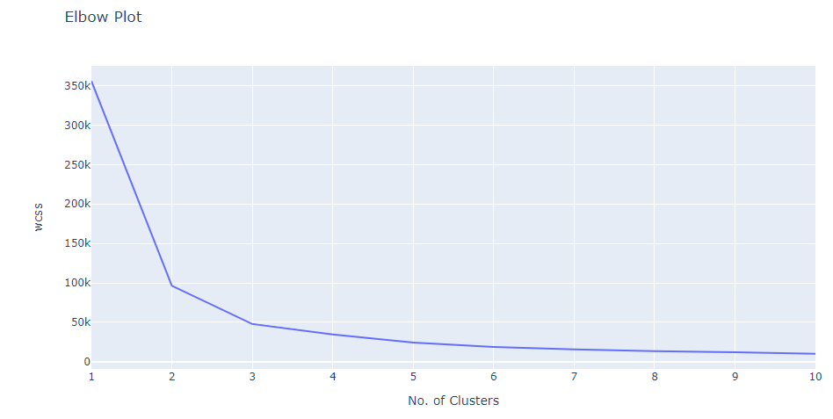
Processing method – K-means Clustering
Through the elbow method, K value of 5 yields the best outcome as the kinks appear to be smoothening out after the 4 clusters

Slide 9
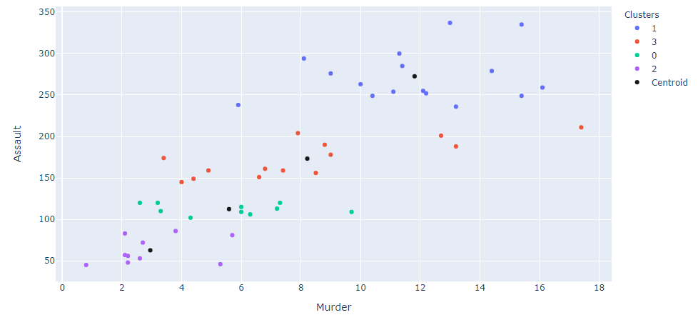
Processing method – K-means Clustering
Below is the scatter plot illustrates the exact output which the clustering algorithm generates for the data pairwise for the Assault & Murder
A Higher assault rates in a particular state seems to be positively correlated to a higher murder rates, and vice versa.

Slide 10
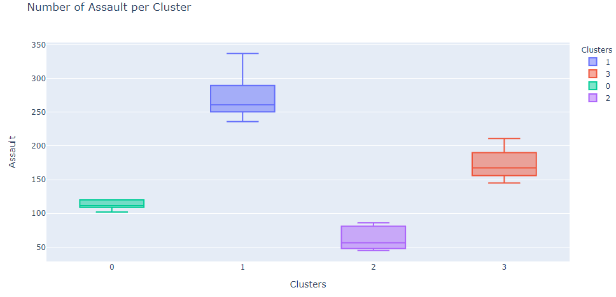
Box plot for number of assault per cluster
States in Cluster 1 has the highest number of assault cases that falls in the range of 250 to 280k cases
States in Cluster 2 has the lowest number of assault cases that falls in the range of 50 to 80k cases

Slide 11
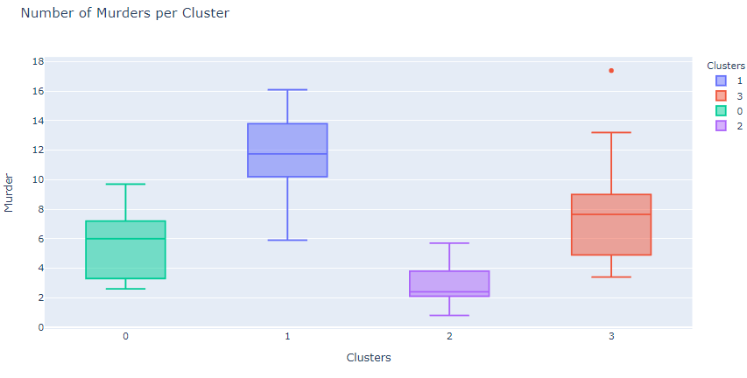
Box plot for number of murder per cluster
Georgia is an outliner under cluster 3 with murder rates of 17.4k arrests.
The murder rates are in the range of 5 to 9k under Cluster 3

Slide 12
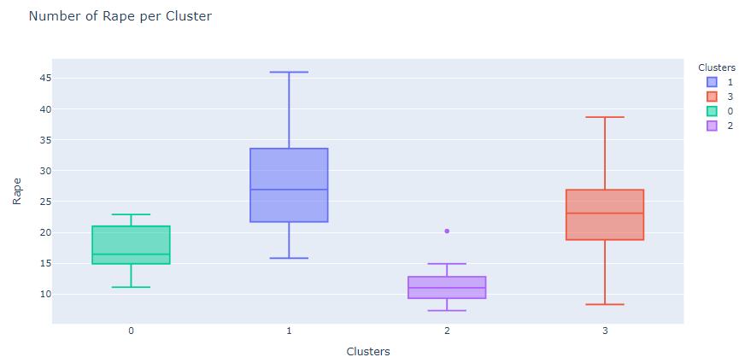
Box plot for number of rape per cluster

Slide 13
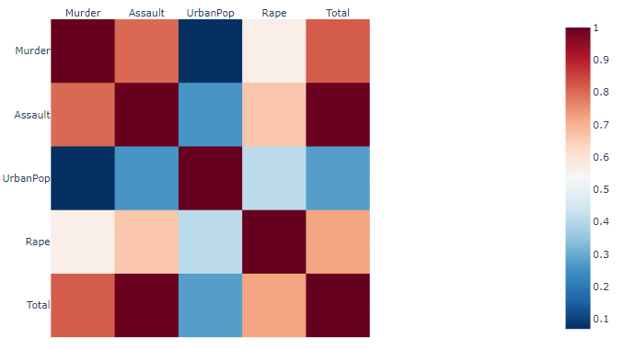
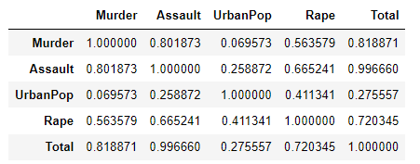
Heat map for total crime rates
The heat map as well as the correlation table confirms the assumptions regarding variable correlations indicated also by the scatter plots.
For example, murder and assault have the highest correlations of 0.80 (in red), whereas the assault and the number of urban population is not significant based on low correlation of 0.06 (in blue).

Slide 14
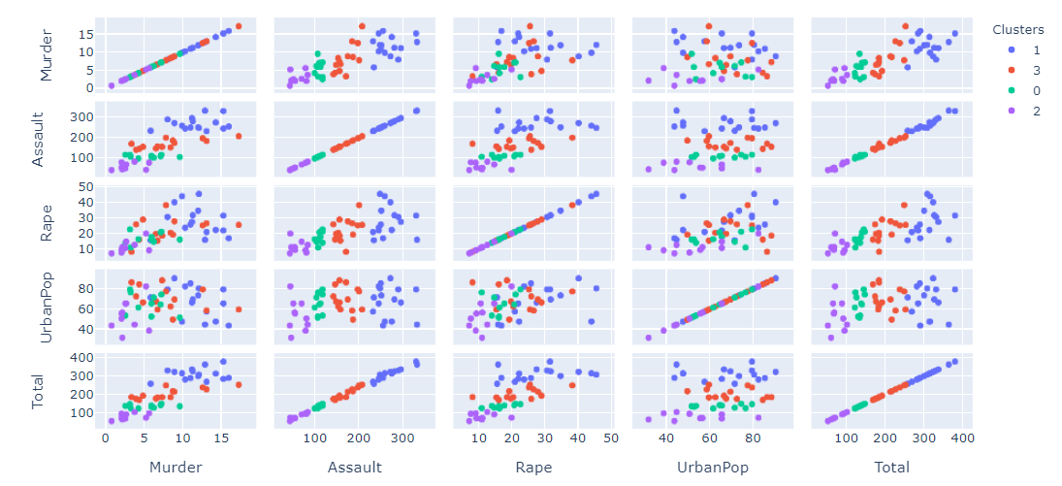
Scatter plot matrix
High Correlation between Murder and Assault
Low Correlation between Assault and Urban Pop
(no clear pattern)

Slide 15
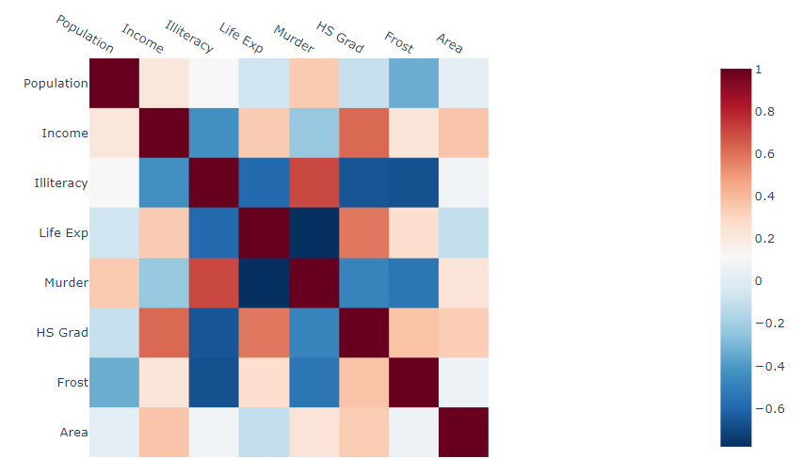
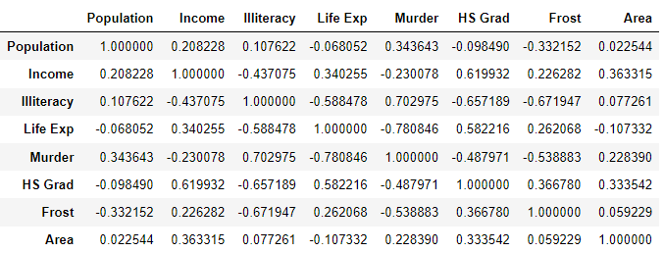

Heat map for total crime rates using USstatex77.csv
The heat map as well as the correlation table also shows that
High positive correlation between murder and illiteracy
High negative correlation between murder and life expectancy
Low correlation between murder and population and land area

Slide 16
Scatter plot matrix
High Correlation between Murder and Assault
Low Correlation between Assault and Urban Pop
(no clear pattern)

Slide 17
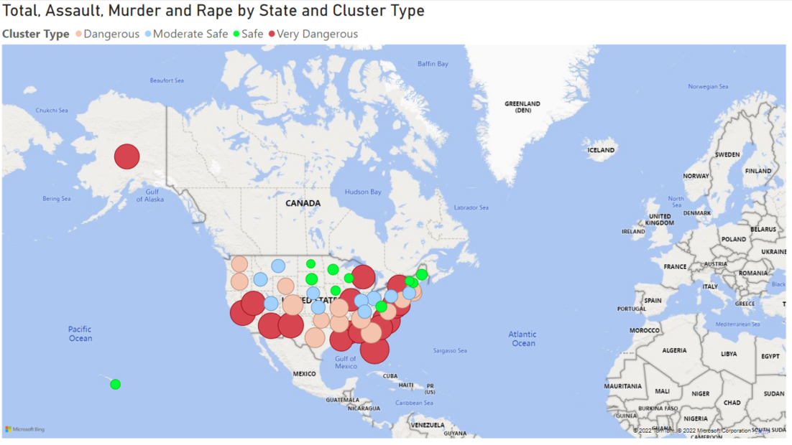
Map visualisation - different clusters types
Cluster 1 - Very Dangerous States: 'Alabama', 'Alaska', 'Arizona', 'California', 'Delaware’, 'Florida', 'Illinois', 'Louisiana', 'Maryland', 'Michigan’, 'Mississippi', 'Nevada', 'New Mexico', 'New York','North Carolina', 'South Carolina’
Cluster 3 - Dangerous States: 'Arkansas', 'Colorado', 'Georgia', 'Massachusetts', 'Missouri’, 'New Jersey', 'Oklahoma', 'Oregon', 'Rhode Island', 'Tennessee’, 'Texas', 'Virginia', 'Washington', 'Wyoming
Cluster 0 - Moderate Safe State: 'Connecticut', 'Idaho', 'Indiana', 'Kansas', 'Kentucky', 'Montana’, 'Nebraska', 'Ohio', 'Pennsylvania', 'Utah’
Cluster 2 - Safe States: 'Hawaii', 'Iowa', 'Maine', 'Minnesota', 'New Hampshire’, 'North Dakota', 'South Dakota', 'Vermont', 'West Virginia’, 'Wisconsin'

Slide 18
